Slide 1
Chapter : Design Engineering

Slide 2
Design Engineering
It covers the set of principles, concepts, and practices that lead to the development of a high quality system or product.
Goal of design engineering is to produce a model or representation that depict:
  Firmness – program should not have any bug that inhibits its functions.
  Commodity – suitable to its intended use.
  Delight - pleasurable to use
The design model provides detail about software data structures, architecture, interfaces, and components that are necessary to implement the system.

Slide 3
Software Design
Software design model consists of 4 designs:
  Data/class Design
  Architectural Design
  Interface Design
  Component Design

Slide 4
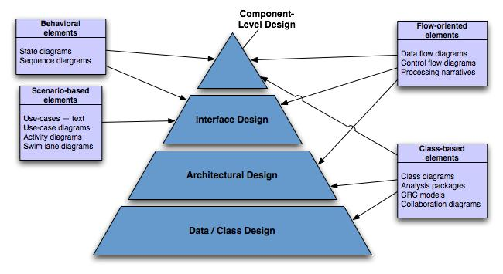
Translating Analysis → Design

Slide 5
Data/class design - Created by transforming the analysis model class-based elements into classes and data structures required to implement the software
Architectural design - defines the relationships among the major structural elements of the software, it is derived from the class-based elements and flow-oriented elements of the analysis model
Interface design - describes how the software elements, hardware elements, and end-users communicate with one another, it is derived from the analysis model scenario-based elements, flow-oriented elements, and behavioral elements
Component-level design - created by transforming the structural elements defined by the software architecture into a procedural description of the software components using information obtained from the analysis model class-based elements, flow-oriented elements, and behavioral elements

Slide 6
Why design is so important?
It is place where quality is fostered.
It provides us with representation of software that can be assessed for quality.
Only way that can accurately translate a customer’s requirements into a finished software product.
It serves as foundation for all software engineering activities.
Without design difficult to assess:
  Risk
  Test
  Quality

Slide 7
Design Process and Design Quality
S/w design is an iterative process through which requirements are translated into a “blueprint” for constructing the s/w.
As design iteration occur, subsequent refinement leads to design representation at much lower levels of abstraction.

Slide 8
Goal of design process
The design must implement all of the explicit requirements contained in the analysis model, and it must accommodate all of the implicit requirements desired by the customer.
The design must be a readable, understandable guide for those who generate code and for those who test and subsequently support the software.
The design should provide a complete picture of the software, addressing the data, functional, and behavioral domains from an implementation perspective.

Slide 9
Quality Guidelines
Characteristics of good design
A design should exhibit an architecture that
  as been created using recognizable architectural styles or patterns,
  is composed of components that exhibit good design characteristics and
  can be implemented in an evolutionary fashion
A design should be modular; that is, the software should be logically partitioned into elements or subsystems
A design should contain distinct representations of data, architecture, interfaces, and components.
A design should lead to data structures that are appropriate for the classes to be implemented and are drawn from recognizable data patterns.
A design should lead to components that exhibit independent functional characteristics

Slide 10
Quality Guidelines (contd.)
A design should lead to interfaces that reduce the complexity of connections between components and with the external environment.
A design should be derived using a repeatable method that is driven by information obtained during software requirements analysis.
A design should be represented using a notation that effectively communicates its meaning.

Slide 11
Design Principles
S/W design is both a process and a model.
Design process - sequence of steps that enable the designer to describe all aspects of the software to be built.
Design model - created for software provides a variety of different views of the computer software

Slide 12
The design process should not suffer from ‘tunnel vision.’ - Designer should consider alternative approaches.
The design should be traceable to the analysis model - a single element of the design model often traces to multiple requirements, it is necessary to have a means for tracking how requirements have been satisfied by the design model.
The design should not reinvent the wheel- use already exists design pattern because time is short and resource are limited.
The design should “minimize the intellectual distance” between the software and the problem as it exists in the real world. – design should be self-explanatory

Slide 13
The design should exhibit uniformity and integration – before design work begins rules of styles and format should be defined for a design team.
The design should be structured to accommodate change
The design should be structured to degrade gently, even when unusual data, events, or operating conditions are encountered.
Design is not coding, coding is not design.
The design should be assessed for quality as it is being created, not after the fact
The design should be reviewed to minimize conceptual (semantic) errors.

Slide 14
Design concepts
Design concepts provide the necessary framework for “to get the thing on right way”.
Abstraction
Pattern
Architecture
Modularity
Functional Independence
Refinement
Information Hiding
Refactoring
Design classes

Slide 15
Abstraction
At the highest level of abstraction – a solution is stated in broad terms
At lower level of abstraction – a more detailed description of the solution is provided.
Two types of abstraction:
Procedural abstraction: Sequence of instructions that have a specific and limited function.
Ex. Open a door
open implies long sequence of activities (e.g. walk to the door, grasp knob, turn knob and pull the door, etc).
Data abstraction: collection of data that describes a data object.
Ex. Open a door. – door is data object.
Data abstraction for door would encompass a set of attributes that describe the door. (E.g. door type, swing direction, opening mechanism, etc.)

Slide 16
Architecture
Software architecture suggest “ the overall structure of the software and the ways in which that structure provides conceptual integrity for a system.
No. of different models can use to represent architecture.
  Structural Model- represent architecture as an organized collection of components
  Framework model – Increase level of design abstraction by identifying repeatable architectural design framework.
  Dynamic model – address behavior of the program architecture and indicating how system or structure configuration may change as a function.
  Process Model – focus on design of the business or technical process that the system must accommodate.
  Functional models – used to represent the functional hierarchy of a system.

Slide 17
Pattern:
Intent of Pattern
1.Whether the pattern is applicable to the current work.
2.Whether the pattern can be reused.
3.Whether the pattern can be served as a guide for developing a similar, but functionally or structurally different pattern.

Slide 18
Modularity
Architecture and design pattern embody modularity.
Software is divided into separately named and addressable components, sometimes called modules, which are integrated to satisfy problem requirement.
modularity is the single attribute of software that allows a program to be intellectually manageable
It leads to a “divide and conquer” strategy. – it is easier to solve a complex problem when you break into a manageable pieces.
Refer fig. that state that effort (cost) to develop an individual software module does decrease if total number of modules increase.
However as the no. of modules grows, the effort (cost) associated with integrating the modules also grows.

Slide 19
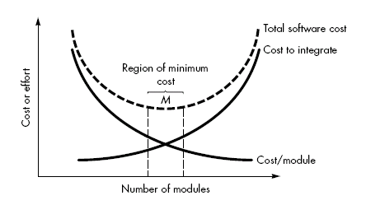
Modularity and software cost

Slide 20
Undermodularity and overmodularity should be avoided. But how do we know the vicinity of M?
We modularize a design so that development can be more easily planned.
Software increments can be defined and delivered.
Changes can be more easily accommodated.
Testing and debugging can be conducted more efficiently and long-term maintained can be conducted without serious side effects.

Slide 21
Information Hiding
The principle of information hiding suggests that modules be "characterized by design decisions that (each) hides from all others modules.“
In other words, modules should be specified and designed so that information (algorithm and data) contained within a module is inaccessible to other modules that have no need for such information.
The intent of information hiding is to hide the details of data structure and procedural processing behind a module interface.
It gives benefits when modifications are required during testing and maintenance because data and procedure are hiding from other parts of software, unintentional errors introduced during modification are less.

Slide 22
Refinement
Refinement is actually a process of elaboration.
begin with a statement of function (or description of information) that is defined at a high level of abstraction.
That is, the statement describes function or information conceptually but provides no information about the internal workings of the function or the internal structure of the information.
Refinement causes the designer to elaborate on the original statement, providing more and more detail as each successive refinement (elaboration) occurs.
Abstraction and refinement are complementary concepts. Abstraction enables a designer to specify procedure and data and yet suppress low-level details.
Refinement helps the designer to expose low-level details as design progresses.

Slide 23
Functional Independence
Functional independence is achieved by developing modules with "single-minded“ function and an "aversion" to excessive interaction with other modules.
In other words - each module addresses a specific sub-function of requirements and has a simple interface when viewed from other parts of the program structure.
Independence is important –
  Easier to develop
  Easier to Test and maintain
  Error propagation is reduced
  Reusable module.

Slide 24
Functional Independence
To summarize, functional independence is a key to good design, and design is the key to software quality.
To measure independence, have two qualitative criteria: cohesion and coupling
Cohesion is a measure of the relative functional strength of a module.
Coupling is a measure of the relative interdependence among modules.

Slide 25
Coupling
Coupling depends on the interface complexity between modules, the point at which entry or reference is made to a module, and what data pass across the interface
In software design, we strive for lowest possible coupling. Simple connectivity among modules results in software that is easier to understand and less prone to a "ripple effect" caused when errors occur at one location and propagate through a system.
It occur because of design decisions made when structure was developed.

Slide 26
Refactoring
It is the process of changing the software system in such a way that it does not alter the external behaviour of the design yet improves its internal structure.
The result of the software which was refactored , that is easier to integrate, easier to test and easier to maintain.

Slide 27
Design Classes
As the design model evolves,the software team must define a set of design classes that:
Refine the analysis classes by providing design detail that will enable the classes to be implemented and
Create a new set of design classes that implement a software infrastructure to support the business solution.

Slide 28
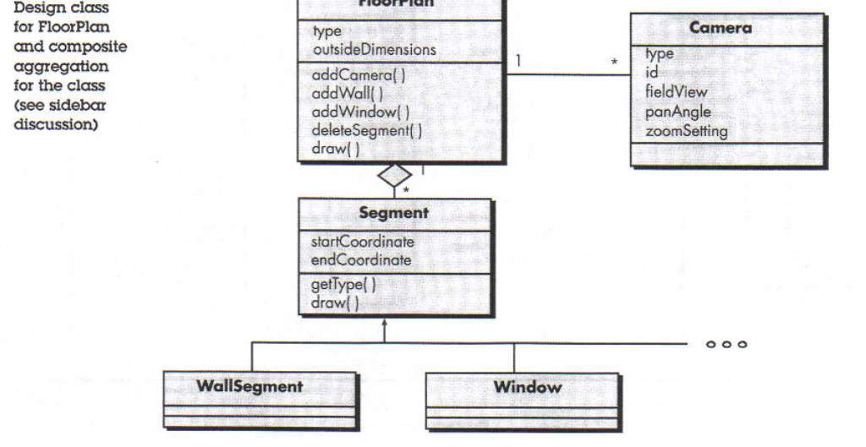

Slide 29
Types of Design Classes
User interface classes – define all abstractions necessary for human-computer interaction (usually via metaphors of real-world objects)
Business domain classes – refined from analysis classes; identify attributes and services (methods) that are required to implement some element of the business domain

Slide 30
Process classes – implement business abstractions required to fully manage the business domain classes
Persistent classes – represent data stores (e.g., a database) that will persist beyond the execution of the software
System classes – implement software management and control functions that enable the system to operate and communicate within its computing environment and the outside world .

Slide 31
Characteristics of a Well-Formed Design Class
Complete and sufficient
  Contains the complete encapsulation of all attributes and methods that exist for the class
  Contains only those methods that are sufficient to achieve the intent of the class
Primitiveness
  Each method of a class focuses on accomplishing one service for the class

Slide 32
High cohesion
  The class has a small, focused set of responsibilities and single-mindedly applies attributes and methods to implement those responsibilities
Low coupling
  Collaboration of the class with other classes is kept to an acceptable minimum
  Each class should have limited knowledge of other classes in other subsystems

Slide 33
The Design Model
The design model can be viewed in two different dimensions
  (Horizontally) The process dimension indicates the evolution of the parts of the design model as each design task is executed
  (Vertically) The abstraction dimension represents the level of detail as each element of the analysis model is transformed into the design model and then iteratively refined
Elements of the design model use many of the same UML diagrams used in the analysis model
  The diagrams are refined and elaborated as part of the design
  More implementation-specific detail is provided
  Emphasis is placed on
    Architectural structure and style
    Interfaces between components and the outside world
    Components that reside within the architecture

Slide 34
Dimensions of the Design Model
High
Analysis model
Abstraction Dimension
Design model
Data/Class
Elements
Architectural
Elements
Interface
Elements
Component-level
Elements
Deployment-level
Elements
Low
Process Dimension (Progression)

Slide 35
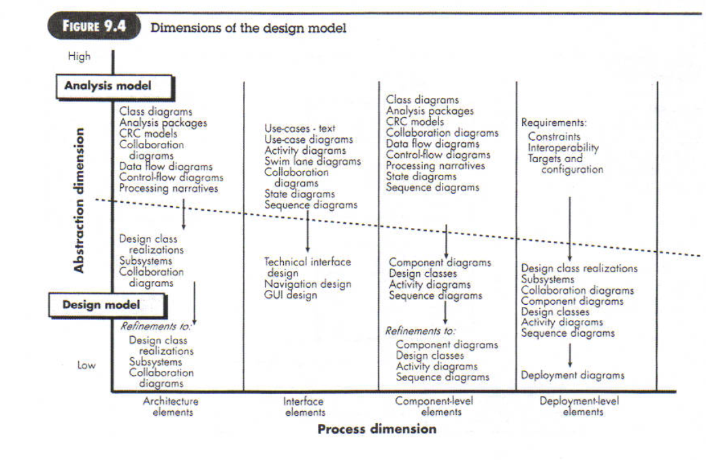

Slide 36
Introduction (continued)
Design model elements are not always developed in a sequential fashion
  Preliminary architectural design sets the stage
  It is followed by interface design and component-level design, which often occur in parallel
The design model has the following layered elements
  Data/class design
  Architectural design
  Interface design
  Component-level design
A fifth element that follows all of
the others is deployment-level design
Component-level Design
Interface Design
Architectural Design
Data/Class Design

Slide 37
Design Elements
Data/class design
  Creates a model of data and objects that is represented at a high level of abstraction
Architectural design
  Depicts the overall layout of the software
Interface design
  Tells how information flows into and out of the system and how it is communicated among the components defined as part of the architecture
  Includes the user interface, external interfaces, and internal interfaces
Component-level design elements
  Describes the internal detail of each software component by way of data structure definitions, algorithms, and interface specifications
Deployment-level design elements
  Indicates how software functionality and subsystems will be allocated within the physical computing environment that will support the software

Slide 38
Pattern-based Software Design
Mature engineering disciplines make use of thousands of design patterns for such things as buildings, highways, electrical circuits, factories, weapon systems, vehicles, and computers
Design patterns also serve a purpose in software engineering
Architectural patterns
  Define the overall structure of software
  Indicate the relationships among subsystems and software components
  Define the rules for specifying relationships among software elements
Design patterns
  Address a specific element of the design such as an aggregation of components or solve some design problem, relationships among components, or the mechanisms for effecting inter-component communication
  Consist of creational, structural, and behavioral patterns
Coding patterns
  Describe language-specific patterns that implement an algorithmic or data structure element of a component, a specific interface protocol, or a mechanism for communication among components
☺

Slide 39
Design quality attributes
Acronym FURPS –
  Functionality
  Usability
  Reliability
  Performance
  Supportability

Slide 40
Functionality – is assessed by evaluating the feature set and capabilities of the program.
  Functions that are delivered and security of the overall system.
Usability – assessed by considering human factors, consistency & documentation.
Reliability – evaluated by
  measuring the frequency and severity of failure.
  Accuracy of output results.
  Ability to recover from failure and predictability of the program.
Performance - measured by processing speed, response time, resource consumption, efficiency.
Supportability – combines the ability to extend the program (extensibility), adaptability and serviceability.

